Slide 1
Component Interaction In Angular
Tushar Raj,
Gaurav Sharma

Slide 2
Ways of Component Interaction
Input binding : Data flow from Parent to Child
Output binding : Data flow from Child to Parent
Service: Sibling components interaction
Local variable : Data flow from Parent to Child
ViewChild: Data flows from Parent to Child

Slide 3
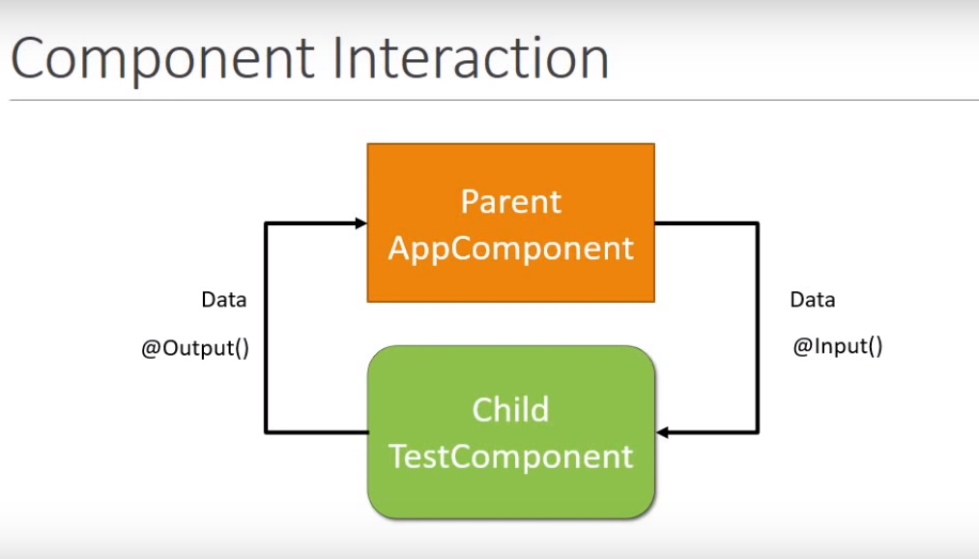

Slide 4
Input binding
Decorator that marks a component field as input property
Bound to DOM property in the parent component template
Parent component will pass the property value
Can provide an alias for the field

Slide 5
Output binding
Output decorator marks a component field as Output property
Child component exposes an output property of EventEmitter type
Parent listens to child event
Data flows from child to parent through events
‘$event’ is used to catch the data sent from child to parent

Slide 6
Limitations till now.
Components need to have parent child relationship

Slide 7
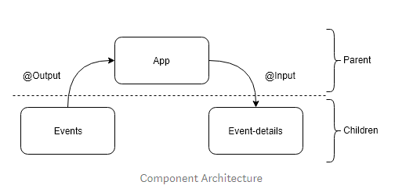

Slide 8
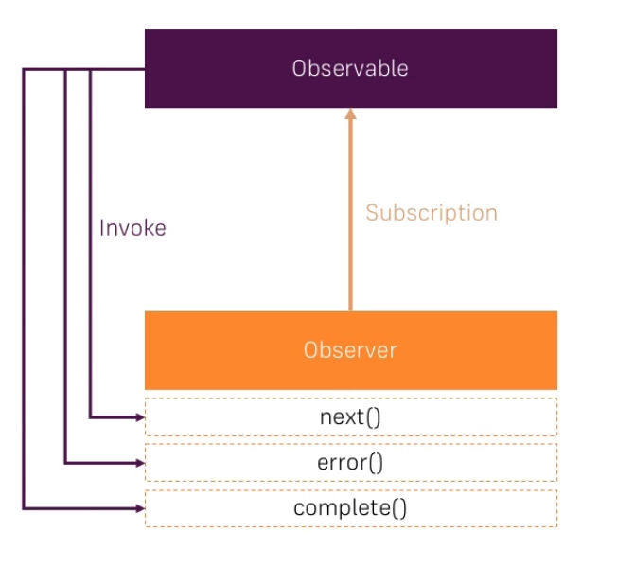

Slide 9
Observable and Observer
An Observable is a wrapper around a data source which emits values/errors to whoever Is listening
Observer subscribes to an Observable and execute some code when a new value is received
Observable only starts emitting values when someone subscribes to it.
Observers implements up to three methods: next, error and complete.
Limitation: Observables are passive i.e. you cannot trigger the emission of new value manually

Slide 10
Subjects
Inherited from Observables
Can trigger the emission of new values manually, just like EventEmitter
Call ‘next’ method of Subject to emit a new value

Slide 11
Service
Singleton objects which gets instantiated only once during the lifetime of application
Contains logic independent to components
Can be used in multiple components
Generally used to make HTTP calls to backend

Slide 12
Local variable
Parent can access child properties and invoke methods
Place a local variable on child component
Local variable gives reference to the child in parent template
Limited in use because all the wiring is in parent template

Slide 13
ViewChild
Template querying mechanism that injects the template elements in component class
Angular fills the ViewChild property only AfterViewInit lifecycle
ViewChild can only see elements inside the template of the component itself
Access child component properties and methods

Slide 14
References
Angular’s documentation https://angular.io/guide/component-interaction
For more details on RXJS library, visit https://rxjs-dev.firebaseapp.com/guide/overview

